Slide 1

Unity 3D Essentials
Course Introduction
SoftUni Team
Technical Trainers
Software University
https://softuni.bg/

Slide 2
Table of Contents
Course Program
Trainers Team
Course Organization
Duration
Practical Programming Exam

Slide 3
Have a Question?
sli.do
#Unity-3D

Slide 4














SoftUni Diamond Partners

Slide 5

Course Program
Unity 3D Essentials

Slide 6
Course Program
Unity Basics
GameObject Scripting
Physics and Collisions
UI Scripting
2D Mode, 2D Physics and Particles
Animations and Audio
Advanced Scripting and Performance Optimizations

Slide 7

Trainers Team

Slide 8
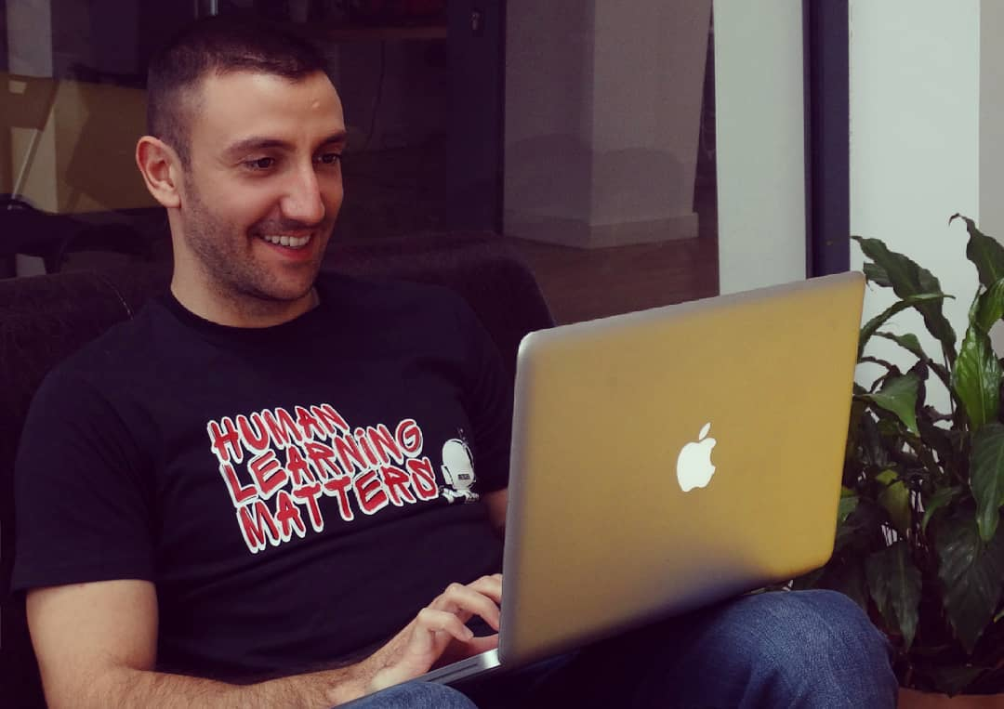
Yordan Strashilov
Unity 3D / C# .NET Developer
Maya 3D / Photoshop hobbyist
Team Lead/Project Lead
Super Bad at Math

Slide 9

Course Organization

Slide 10
Training Duration
Lessons: ~11h
Practical exercises: ~10h
Exam: 5-6 hours
Test
Practical exam
Schedule: April-May 20201
Exam date: 27th of June 2021 and 3rd of July(retake)

Slide 11
Practical Programming Exam
6 problems for 4 hours
Each solved problem gives certain amount of points
Min points for passing the exam - 20
Max points - 60

Slide 12
Questions?
Notes:
‹#›

Slide 13

License
This course (slides, examples, demos, exercises, homework, documents, videos and other assets) is copyrighted content
Unauthorized copy, reproduction or use is illegal
© SoftUni – https://about.softuni.bg
© Software University – https://softuni.bg
Notes:
‹#›

Slide 14
Trainings @ Software University (SoftUni)
Software University – High-Quality Education, Profession and Job for Software Developers
about.softuni.bg, softuni.org
Software University Foundation
softuni.foundation
Software University @ Facebook
facebook.com/SoftwareUniversity
Software University Forums
forum.softuni.bg
Notes:
‹#›

